Slide 1
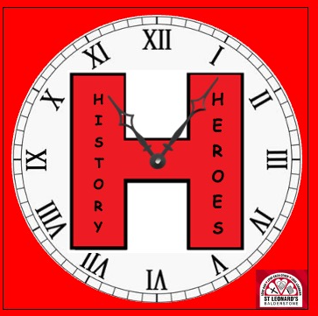
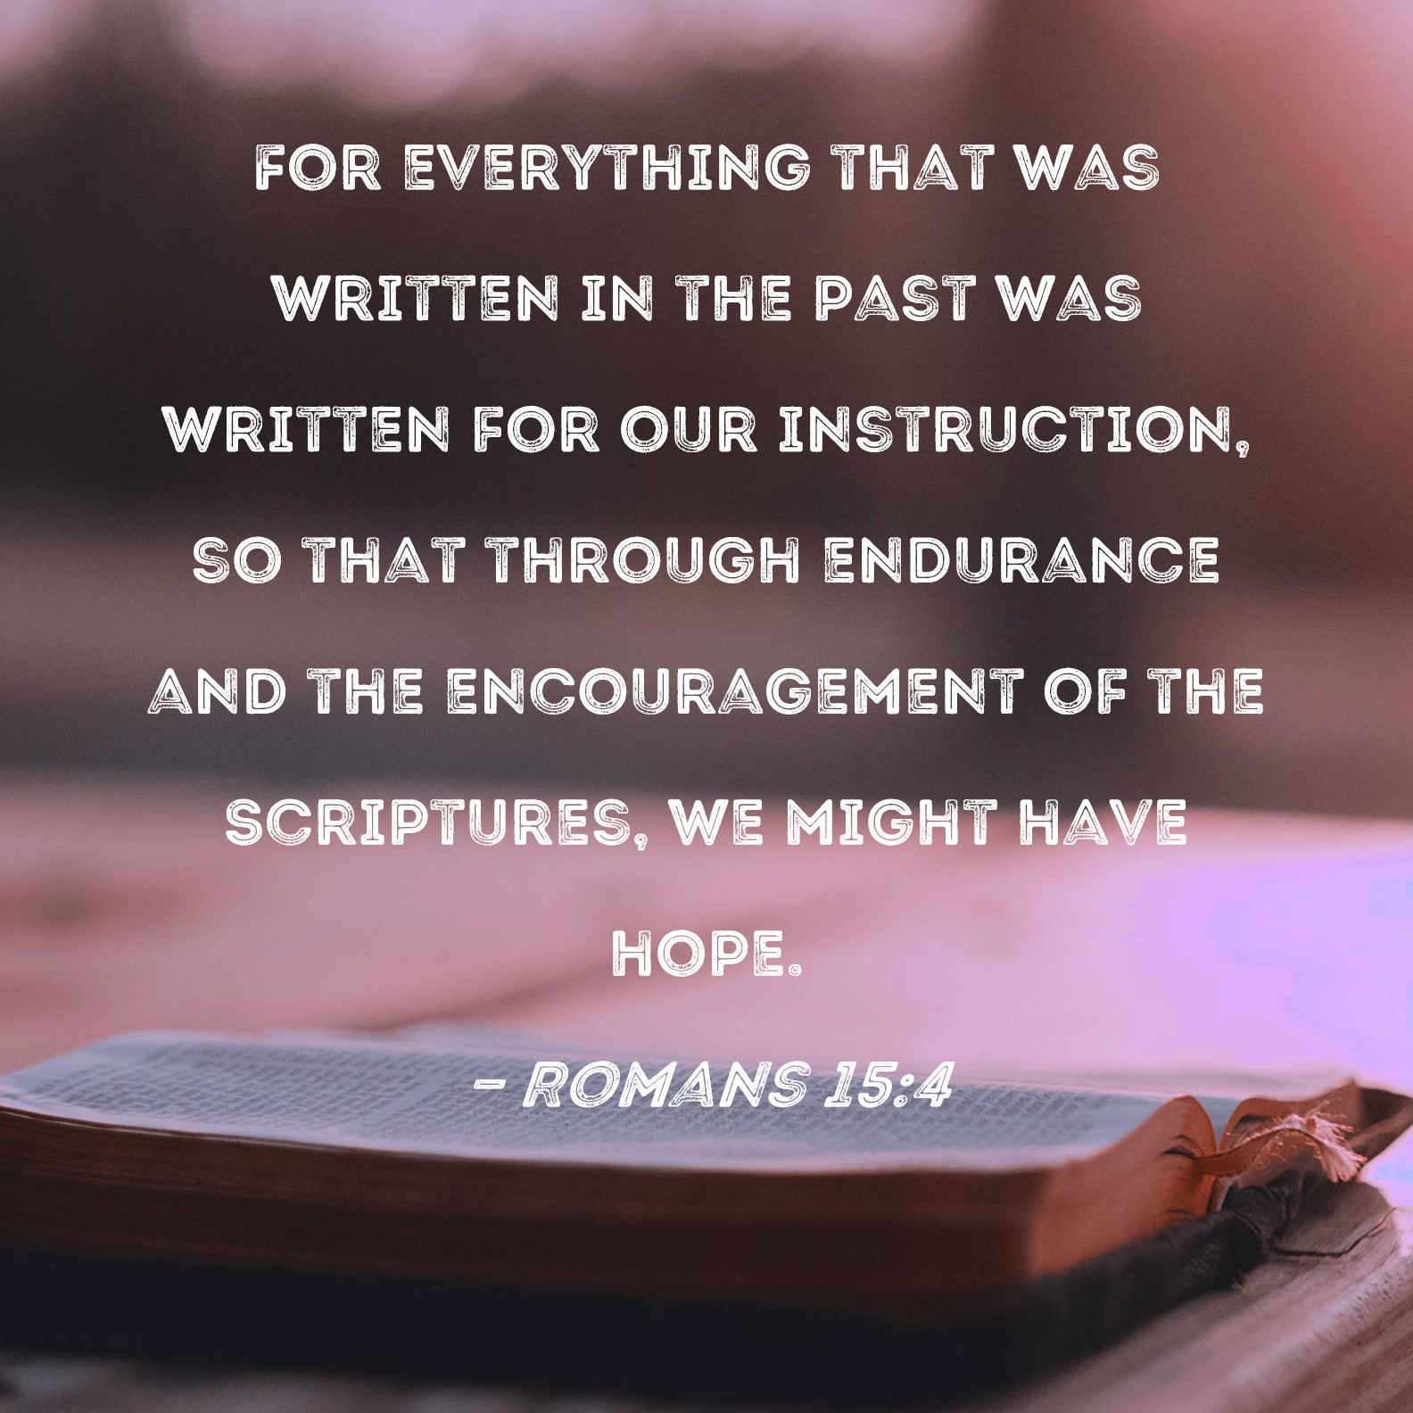

Slide 2
History Heroes –
Mrs Turner – History Champion
Mrs Gow – Head Teacher
Mrs Smith – Parent of Year 6 child and History Governor.
Year 6 | Year 5 | Year 4
Sophie Matilda Aisha Khadija Iman | Amaarah Laura Maisie Sawdah William | Poppy B Juwairiah Abdullah Zayn

Slide 3

1.) Learning, teaching and achievement
This quality is concerned with ensuring effective learning through appropriate and motivating teaching that engages all pupils consistently throughout the school.

Slide 4
1.1 How well do the pupils understand the purpose of history? .
Evidence 1 – Children talking about why history is special at Balderstone.
https://www.balderstoneschool.co.uk/page/?title=HISTORY+HEROES+%2D+we+bring+the+past+to+life%21&pid=197
Evidence 2 – Governor report – Findings
Mrs Smith (parent and History Governor ) and Kate Turner (subject champion) met for a chat with the children and a book look – focusing on Vocabulary covered
Example KS1 – parliament, monarch, Samuel Pepys etc…
We chose a selection of children from each class, including SEND, PP and Children working at greater depth to explain their new history learning using the vocabulary list.
The children were able to evidence clearly what they were learning in history and why. Mrs Smith found their enthusiasm for History was amazing.
The next few slides are taken from Mrs Smith’s history Governor Review.

Slide 5
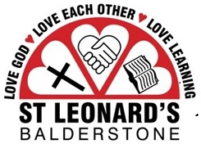
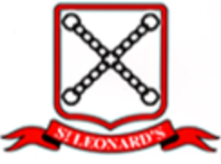
Subject Review: History
5
Findings

Slide 6
Subject Review: History Findings
Topics had been selected in line with the National Curriculum covering a comprehensive range of interesting subjects suitable for students of each age group
Historical events for teaching were selected taking account of:
aspects of British as well as global history
an assessment of the level of interest the topic would generate amongst the diverse range of students at the school
the geography of the local area, which in the immediate vicinity of the school is a farming community
the diversity of backgrounds of the students including the fact that some have an ancestry in a different country
access to local resources such as the history tours at Samlesbury Hall (14th century historic house), the important Egyptology exhibition at Blackburn museum, the World War 1 exhibitions at Accrington library and Accrington Town Hall, and the Pendle Witches trails in Barrowford and Lancaster

Slide 7
Subject Review: History Findings
A ‘History - Whole School Progression’ document was in place providing detailed information on the areas to be covered in each year group for each term. This was in use in all classes
This incorporates:
required work and required understandings in each area plus key questions / key vocabulary
pictorials highlighting the key areas impacted by or to be considered in relation to the topic, e.g. culture and society, religion and faith, justice and laws
A list of notable historical figures to be included in the teaching
Historical events are generally taken in chronological order. Examples of topics are:
Stone Age/Iron Age/Pendle Witches - Year 3/4 (the Pendle Witch trial is a local historical event)
Ancient Greeks/ Ancient Egyptians – Year 3/4
World War 1 - Year 5/6
Roman Empire/Anglo Saxons/Vikings – Year 5/6
Baghdad – Year 5/6 (Baghdad has a clear link to some of the children’s heritage)

Slide 8
Subject Review: History Findings
The ‘golden threads’ had been taken account of, for example:
Monarchy thread: there was a clear focus on the monarchs in place during each of the events/time periods
Cultural threads: clear links had been made with farming, for example the teaching plan covered the change of land use during World War 1 and also the fact that lands were sold off and divided into smaller parts during King James’ 1 time (topic: Pendle Witches), changing the way the community could manage and farm the land
Consideration had also been given to providing information on the class differences of those involved in the events
Threads linking to other subjects, for example:
Reading: World War 1 was studied at the same time as ‘Private Peaceful’ was being read in years 5/6
Art: Students created artworks based on World War 1 that were entered into a national competition and displayed at Blackburn museum, and also created realistic models of trenches

Slide 9
Subject Review: History Findings
Religious Education: There was a clear focus on the part played by religious beliefs in historical events, as evidenced by the discussions with the students
Drama: Role-play was utilised, as well as ‘dress-up’ days where students could attend school dressed as a historical figure. For example, one student had dressed up as James 1 and the other students had posed questions to her
It had also been noted that the threads worked better if just a few were selected rather than having too many.

Slide 10
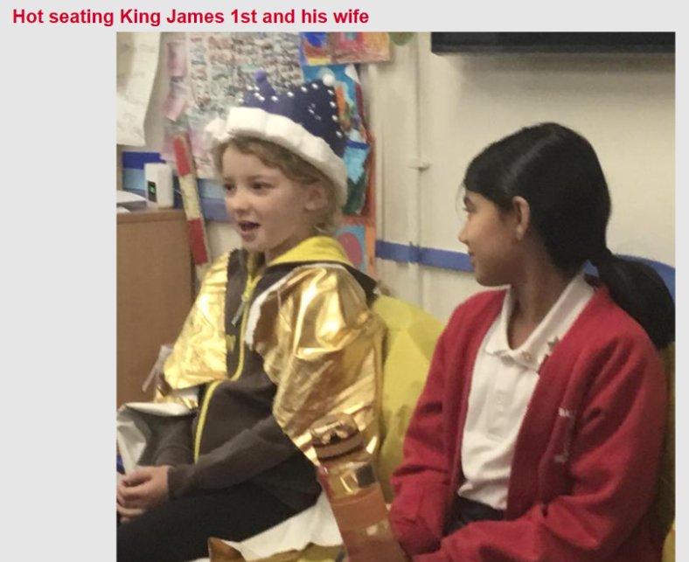
Subject Review: History Findings

Slide 11
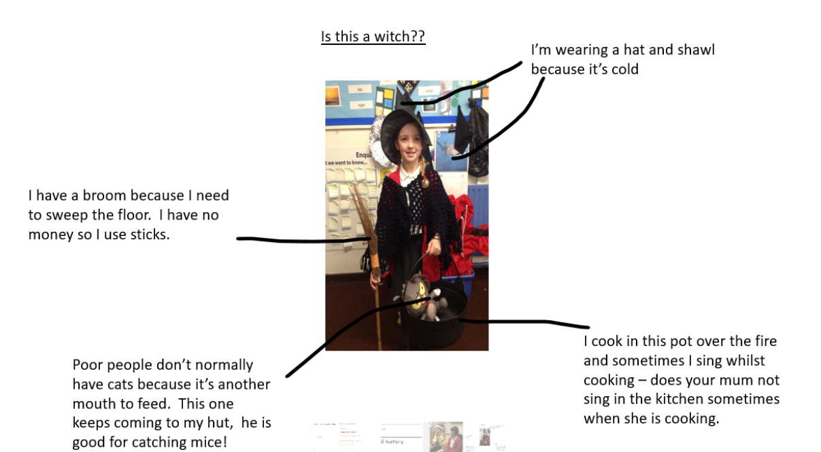
Subject Review: History Findings

Slide 12
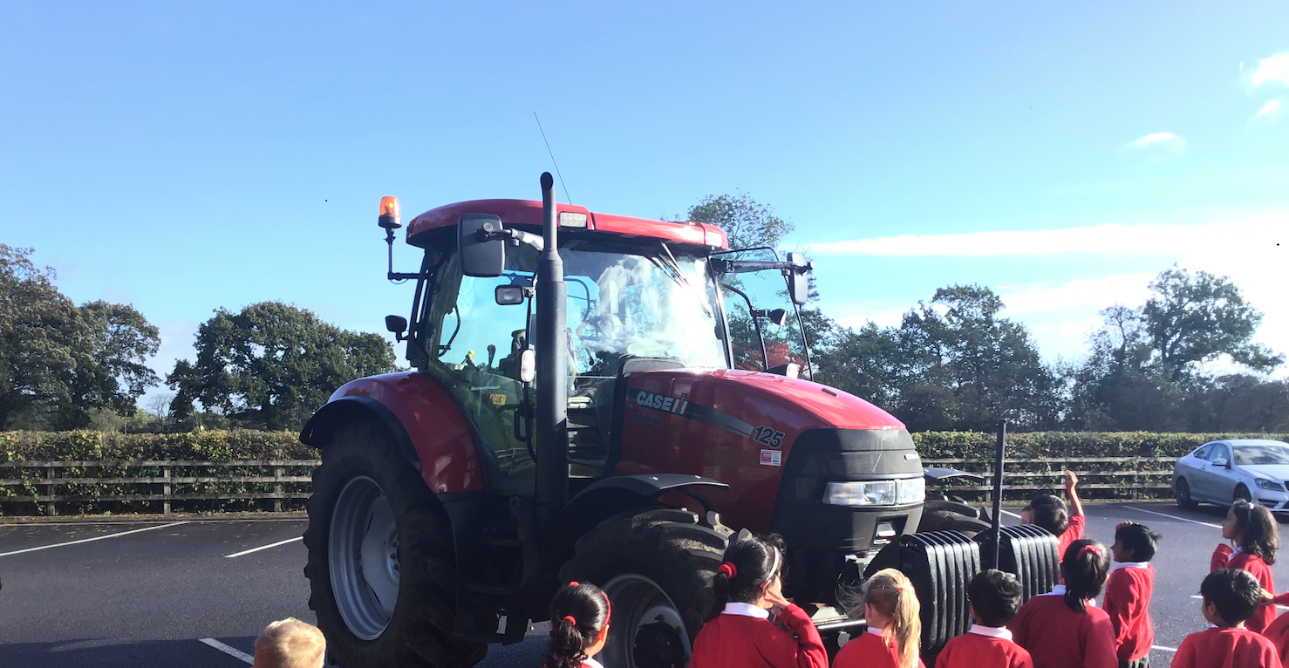
Subject Review: History Findings
Modern tractor visit to school to promote discussion on how farming methods have changed and how this has impacted people’s lives

Slide 13
Subject Review: History Findings
Appropriate key historical figures had been selected for study, for example:
Guy Fawkes, King James 1, Tutankhamun, Howard Carter
Attention had been paid to the fact that there should be parity with English in terms of written notes and extended writing, and this was being worked on through the introduction of knowledge notes
There was an awareness of the need to find effective ways to engage SEND pupils as well as push high performing students
Vocabulary was noted as a key area of focus
Importance was attributed to whether or not the information was ‘sticking’. Areas for improvement had already been identified and plans were in place to follow this up in class through consultation between the subject leader and the class teachers

Slide 14
Subject Review: History Findings
The opportunity had been taken to utilise current events and link these to the teaching of History, e. g. the recent death of the queen
A ‘History Council’ had been created consisting of enthusiastic members from each year group. The council met regularly and had promoted history learning via whole school presentations and the creation of the history timeline/chronology banner displayed in the corridors
Regular student visits were taking place to key local resources. Recent places visited included Samlesbury Hall, the Egyptology exhibition at Blackburn museum and the World War 1 exhibitions at Accrington library and Accrington Town Hall

Slide 15
Subject Review: History Findings – Workbook Review
A review of the student workbooks from all school year groups was carried out. The sample included the workbooks of SEND students, pupil premium students, students of average ability, and high-performing students. It was noted that:
Alternative methods of organising and recording information were provided to the SEND students e. g. pictures were utilised and ‘matching’ exercises were set. It was noted that the pictorial ‘ribbons’ particularly suited the SEND children rather than the knowledge notes
Higher performing students were encouraged to obtain and display additional knowledge (which was also shared with the class or during trips). They were also requested to assist with organising teaching material and learning tools in order to enhance engagement
The student workbooks of average and above average students displayed a good level of knowledge and understanding and use of the ‘threads’ was clear. For example students referred to the monarchy and religion; some more loosely to farming

Slide 16
Subject Review: History Findings – Workbook Review
Vocabulary ‘jigsaws’ appeared to be working well and where vocabulary was noted as missing, plans were in place to revisit this in class and raise the profile at the next staff meeting
Written notes were of a good standard but Mrs Turner was keen to raise the standard further

Slide 17
Subject Review: History Findings – Teachers’ Floor Books
A sample of teachers’ floor books were reviewed, as follows:
EYFS – History Floor Book
This is currently being trialled by Mrs Draycott for EYFS, and was designed to aid the memory of learning using visual clues
Years 1/2 - History Topic ‘Big book’
This is currently also being trialled by Mrs Draycott for years 1/2 and is structured like a diary of learning to capture incidental learning moments not recorded within individual exercise books e. g. the photos of the modern tractor visit in school
Mrs Turner outlined that the next steps were to:
carry out a final review with Mrs Draycott to clarify outstanding questions
discuss/ratify these at the next staff meeting (already added to the agenda)

Slide 18
Subject Review: History Findings – Face-to-face Interviews with Students
Face-to-face interviews were carried out with students from all year groups (years 3/4 were engaged on another activity on the day and were met with on a later occasion)
Findings were:
Students from all year groups were very excited to talk about their history learning and demonstrated an extremely high level of engagement and enthusiasm
The students were very proud of their workbooks and delighted to show them to us
Most students from all year groups interviewed demonstrated a high level of knowledge of the topic they had been studying (some had not looked at the topic for some time but still retained a good level of knowledge and detail). For example, one student remembered straight away when questioned that the date of the Gunpowder Plot was 1605

Slide 19
Subject Review: History Findings – Face-to-face Interviews with Students
A more in-depth knowledge was demonstrated by some students, for example the names of key individuals were retained – the very first fact about the Great Fire of London proffered by one student was that the name of the baker on Pudding Lane was Thomas Farriner
Religion came through strongly (although it was noted that the year 1/2 students interviewed needed a clearer understanding of Catholics and Protestants)
For EYFS children, history lessons had been designed to create an understanding of chronology and the passage of time by reviewing photos of themselves as babies, and photos of notable figures such as the Queen at various stages of her life. Students responded well to this, recognising themselves when they were younger and recognising the younger Queen in her uniform during the war. However it was noted that they needed further work on articulating ‘old/new’
Particularly good recall was noted from the year 6 student, who recalled facts on World War 1 (however she was unaware of the monarch at that time)

Slide 20
Subject Review: History Findings – Face-to-face Interviews with Students
Students responded extremely well when asked questions such as “How do we know that?”, “What have we learned?” and “What do we do differently now?”, evidencing that they were able to process the information and gain a good understanding of the topics covered
When asked whether they liked History, all students responded with great enthusiasm that they did. The instant response from the Reception children was that they all simultaneously put both hands in the air and yelled a resounding “Yes!!”

Slide 21
Subject Review: History Findings – Face-to-face Interviews with Students
Subsequent interview with year 3/4: 13th January 2023
The students had already requested a discussion on the Pendle Witches prior to this review, because they were “bursting talk to someone about it!”. They expressed a huge amount of enthusiasm and couldn’t wait to share their knowledge
On the day, all displayed a detailed knowledge of the subject and were ‘falling over themselves’ to impart their knowledge and show their workbooks
All discussed the sequence of events with remarkable maturity and were able to respectfully disagree on their interpretations of the events based on what they had learned
All were able to understand that accounts of the events differed according to different sources

Slide 22
Subject Review: History Findings – Face-to-face Interviews with Students
When questioned on what we had learned from the events of the Pendle Witch trial, the students gave a number of sensible, well-informed responses, and demonstrated an understanding of the circumstances in place at the time that drove the events, but which no longer exist

Slide 23
Subject Review: History Findings – Discussions with History Lead
Mrs Kate Turner, History Lead:
expressed a real passion for the subject of history
expressed a strong desire to deliver second-to-none history teaching at Balderstone St. Leonard’s
demonstrated a proactive approach and had a ‘continuous improvement’ mindset

Slide 24
1.2 How does history teaching impact upon learning and achievement?
Evidence 1
Teachers have clear objectives and use a wide range of approaches to help children engage, learn and remember.
Knowledge notes (shown on next slide) give all children the opportunity to revisit previous learning to ensure it ‘sticks’, and key questions to focus and guide the learning. To help independence; children can record their learning in a way suitable for them.
Evidence 2
Children teaching children – the children want to teach others. Example – children asked if they could be hot seated as King James 1st. They did their own research – brought in costumes and answered – in detail – questions from the children.
They have organised and taught their own after school clubs. KS2 – finding out more about Pendle Witches. KS1 – learning about the timeline.
Children have been so enthused by their history learning – they have continued their learning with family.
Children went to London to see the great fire of London monument.
Children and staff, went to Lancaster to walk in the footsteps of the Pendle Witches and also the Pendle witch trail.

Slide 25
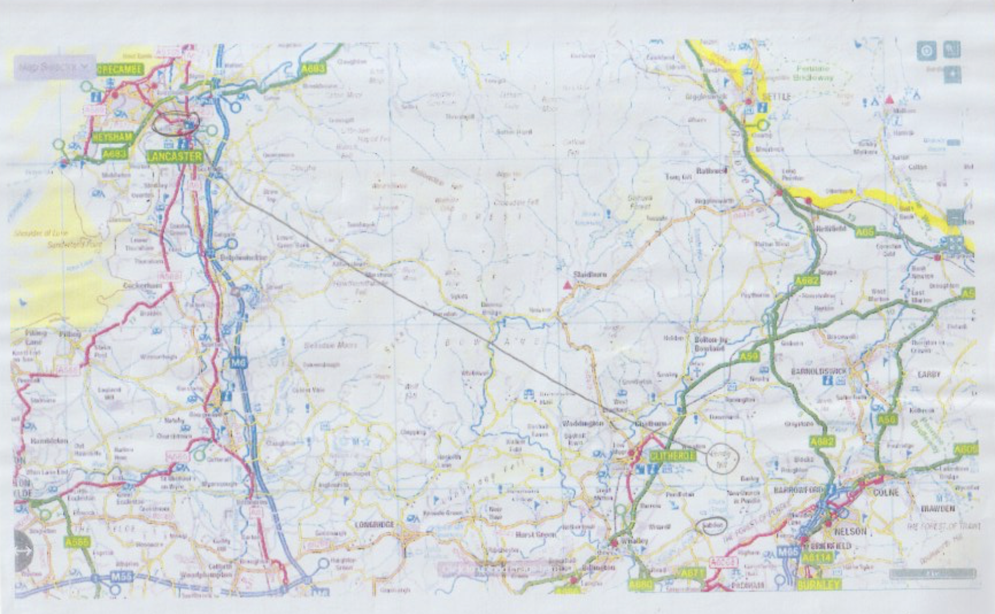
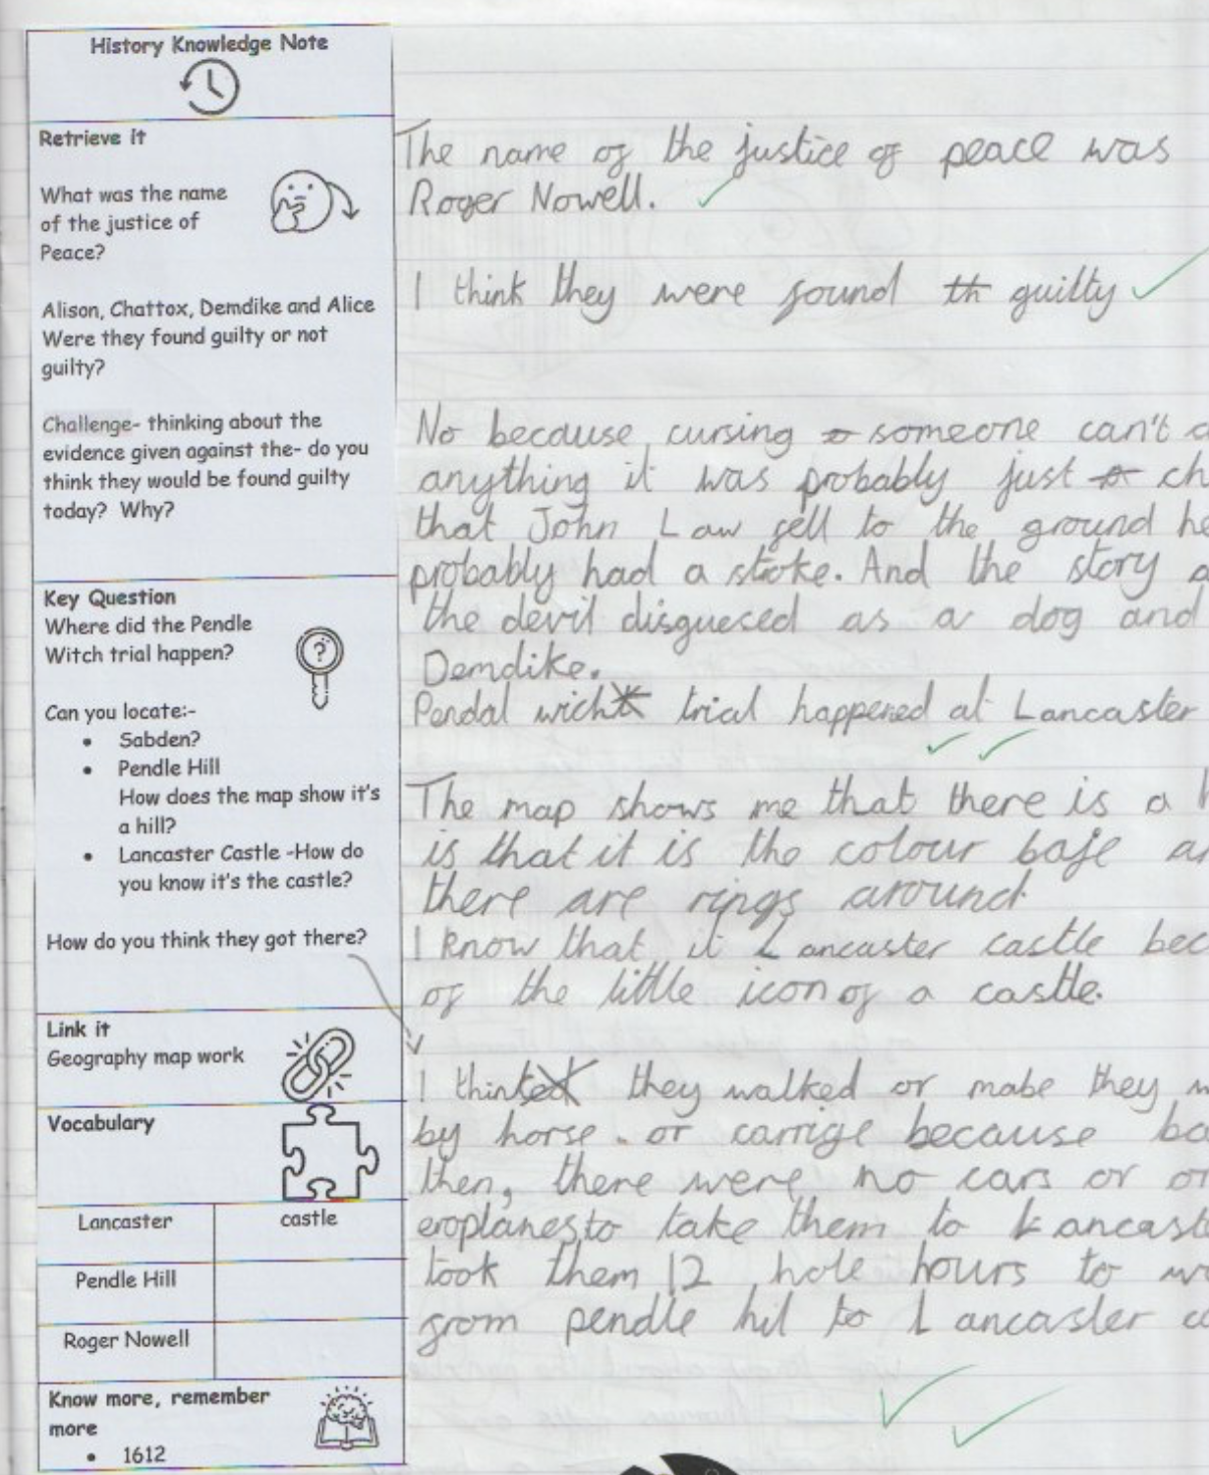
Evidence 1

Slide 26
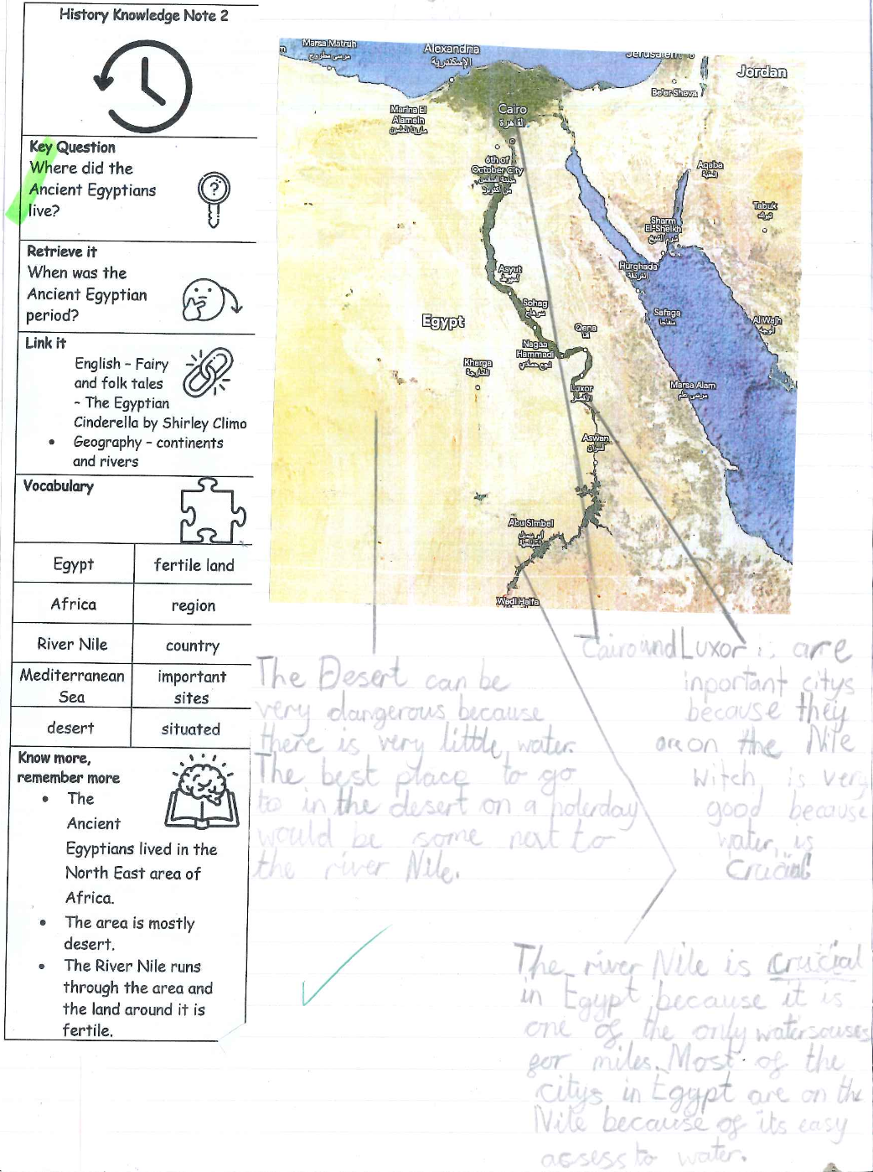
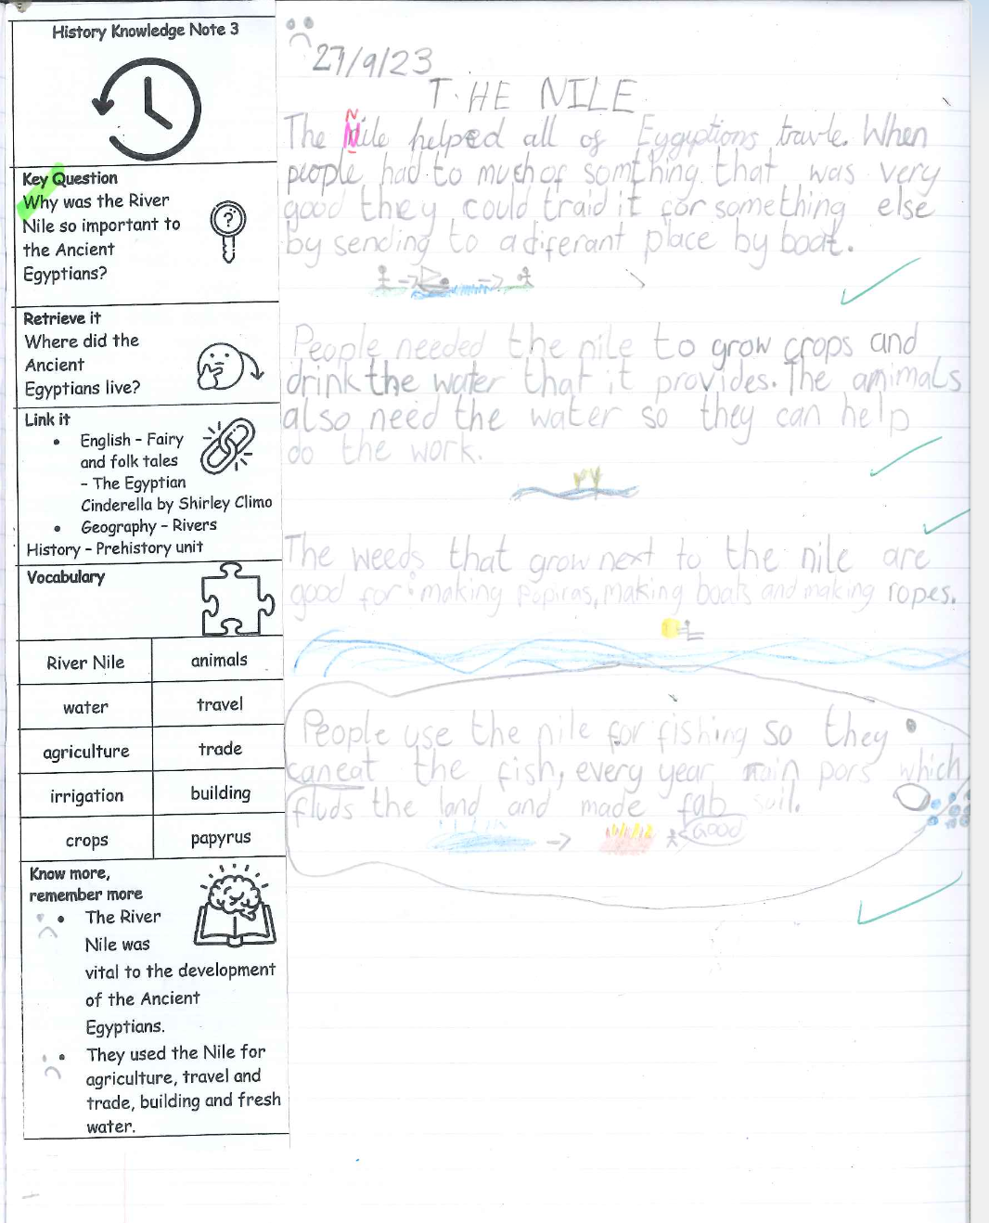

Slide 27
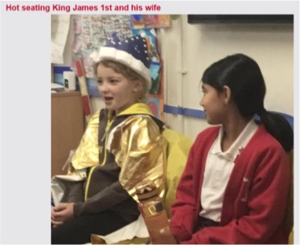
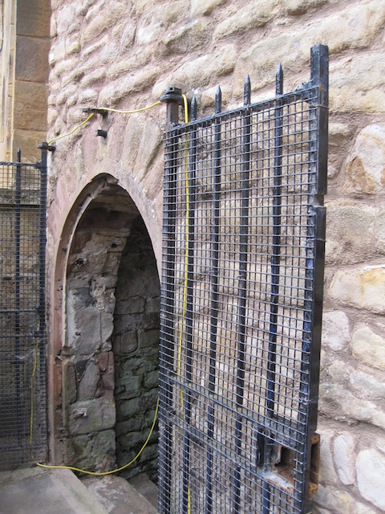
Evidence 2 - Children teaching children –
The children are so enthusiastic – they want to take the learning further and teach others.
Children taking their own learning (with family) beyond the classroom.
.
“It’s amazing to think I have walked and stood where the Pendle Witches were at Lancaster’’ Poppy B

Slide 28
1.3 How effectively are resources deployed to aid learning and achievement?
Evidence 1 - PHOTO SLIDE 1 and 2
Wherever possible, we try to make sure that the children are able to handle artefacts or see them at a museum – bringing history to life and engaging curiosity.
We go to the Egyptian display at our local museum at Blackburn.
We aim to go to all special events offered by our local heritage team: dark ages, castle crushers, WW2. Shakespeare in March.

Slide 29
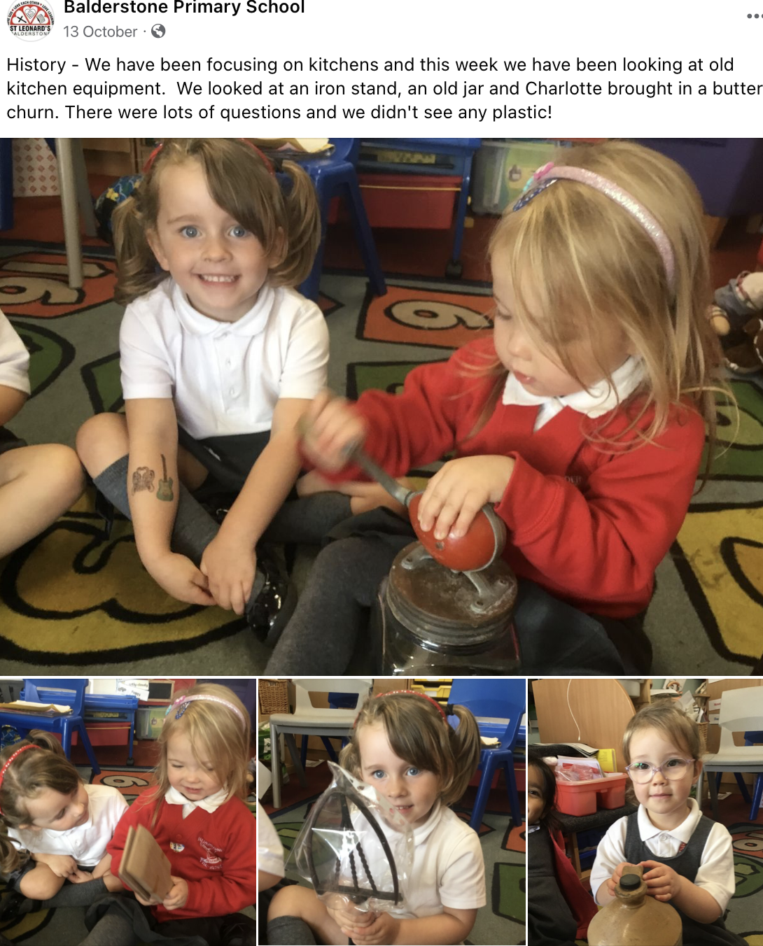
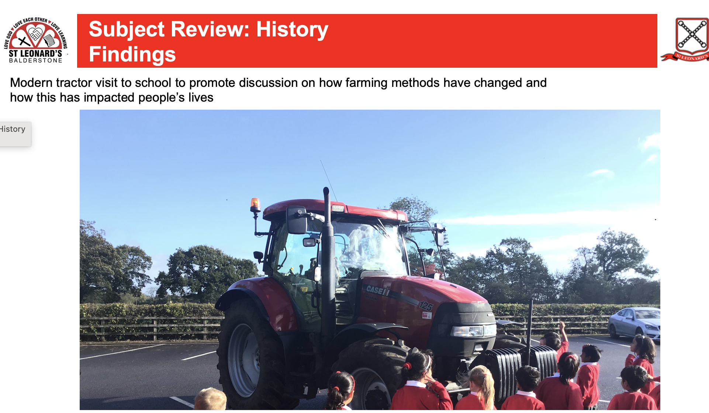
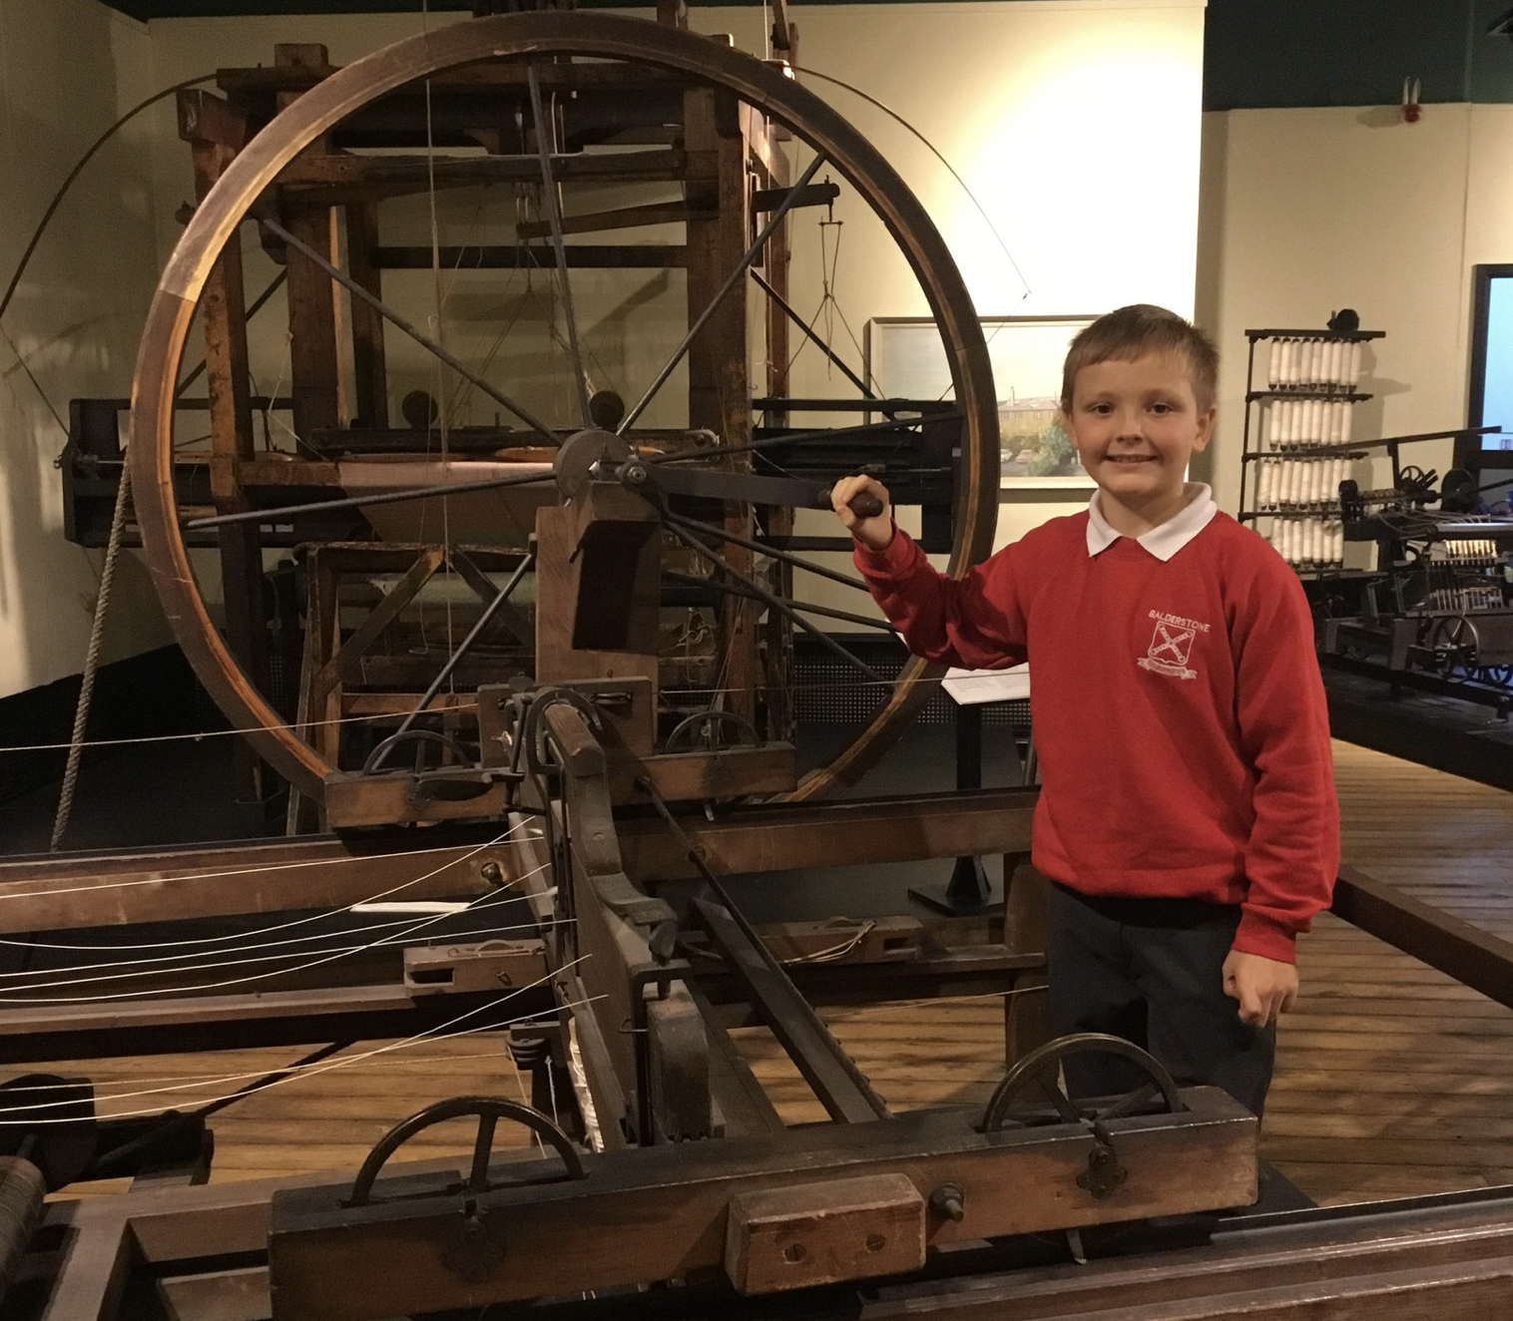
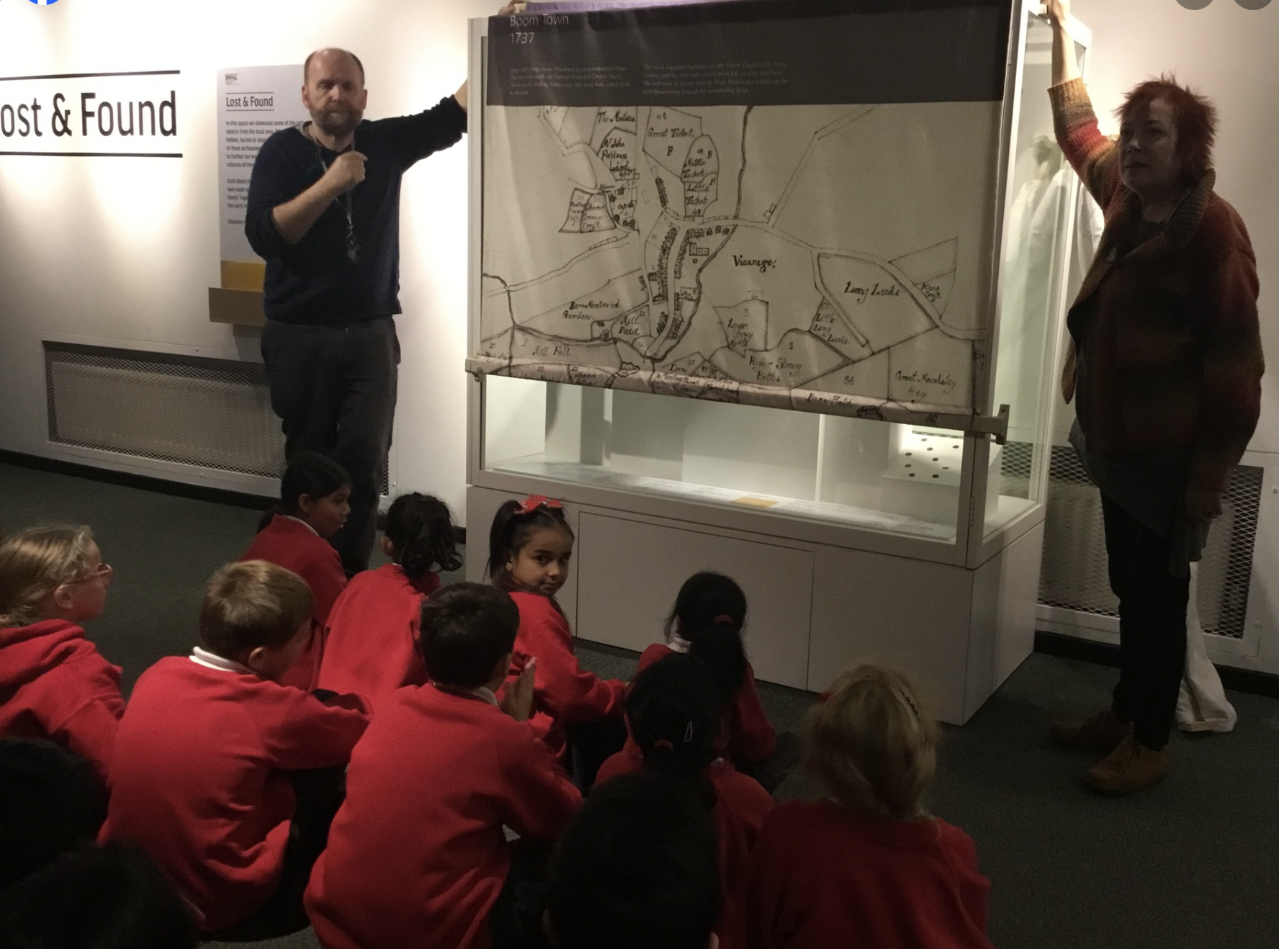
Photo Slide 1

Slide 30
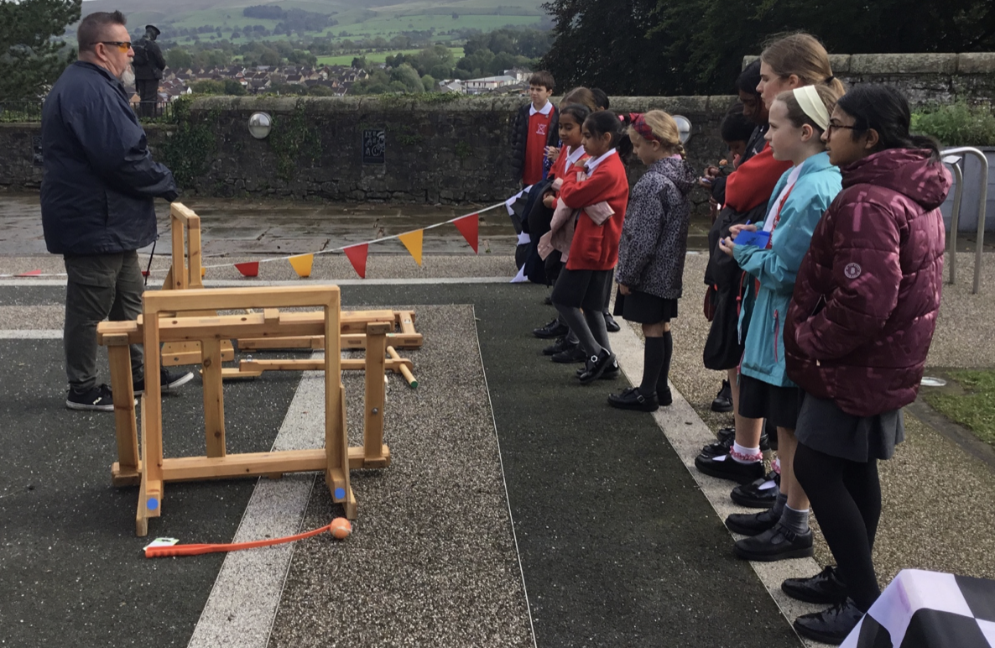
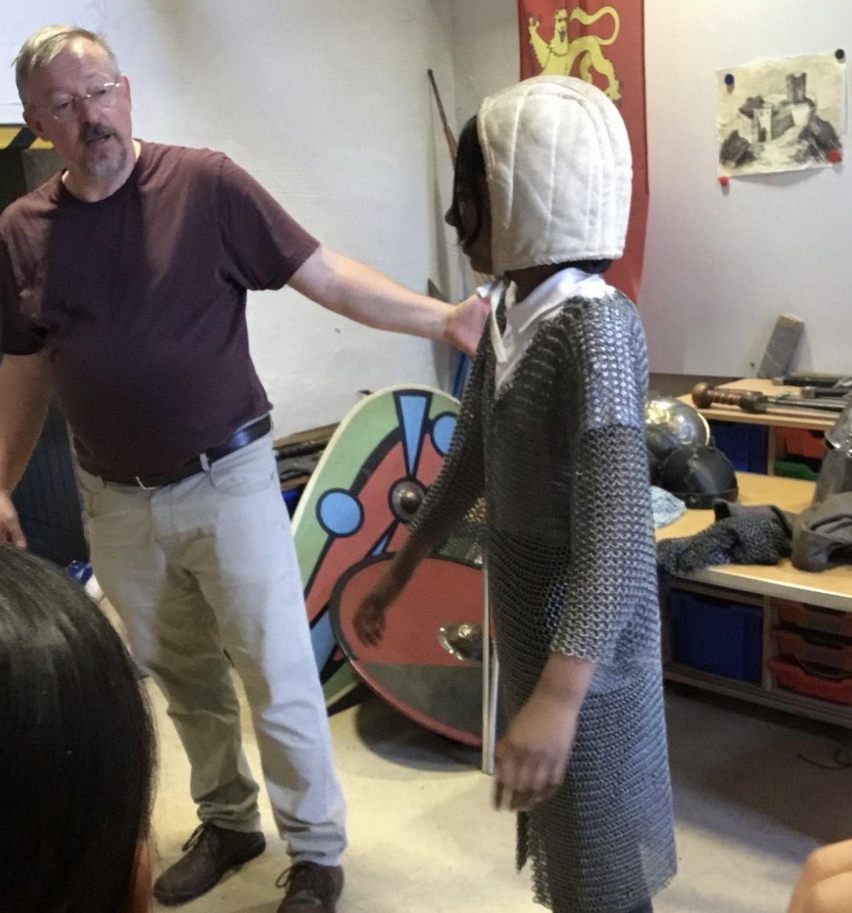
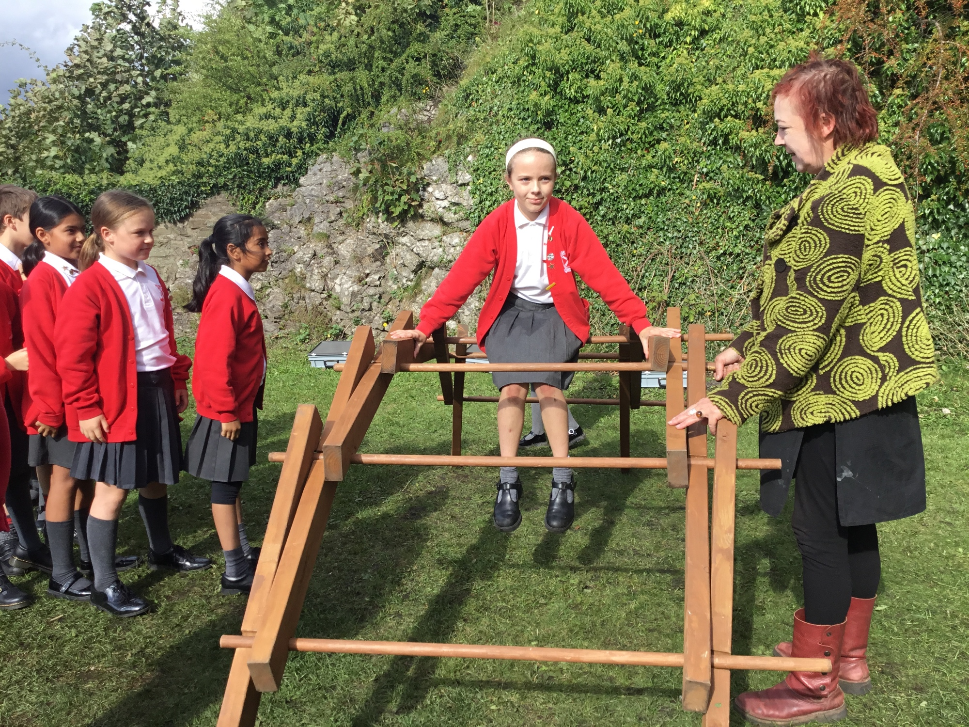
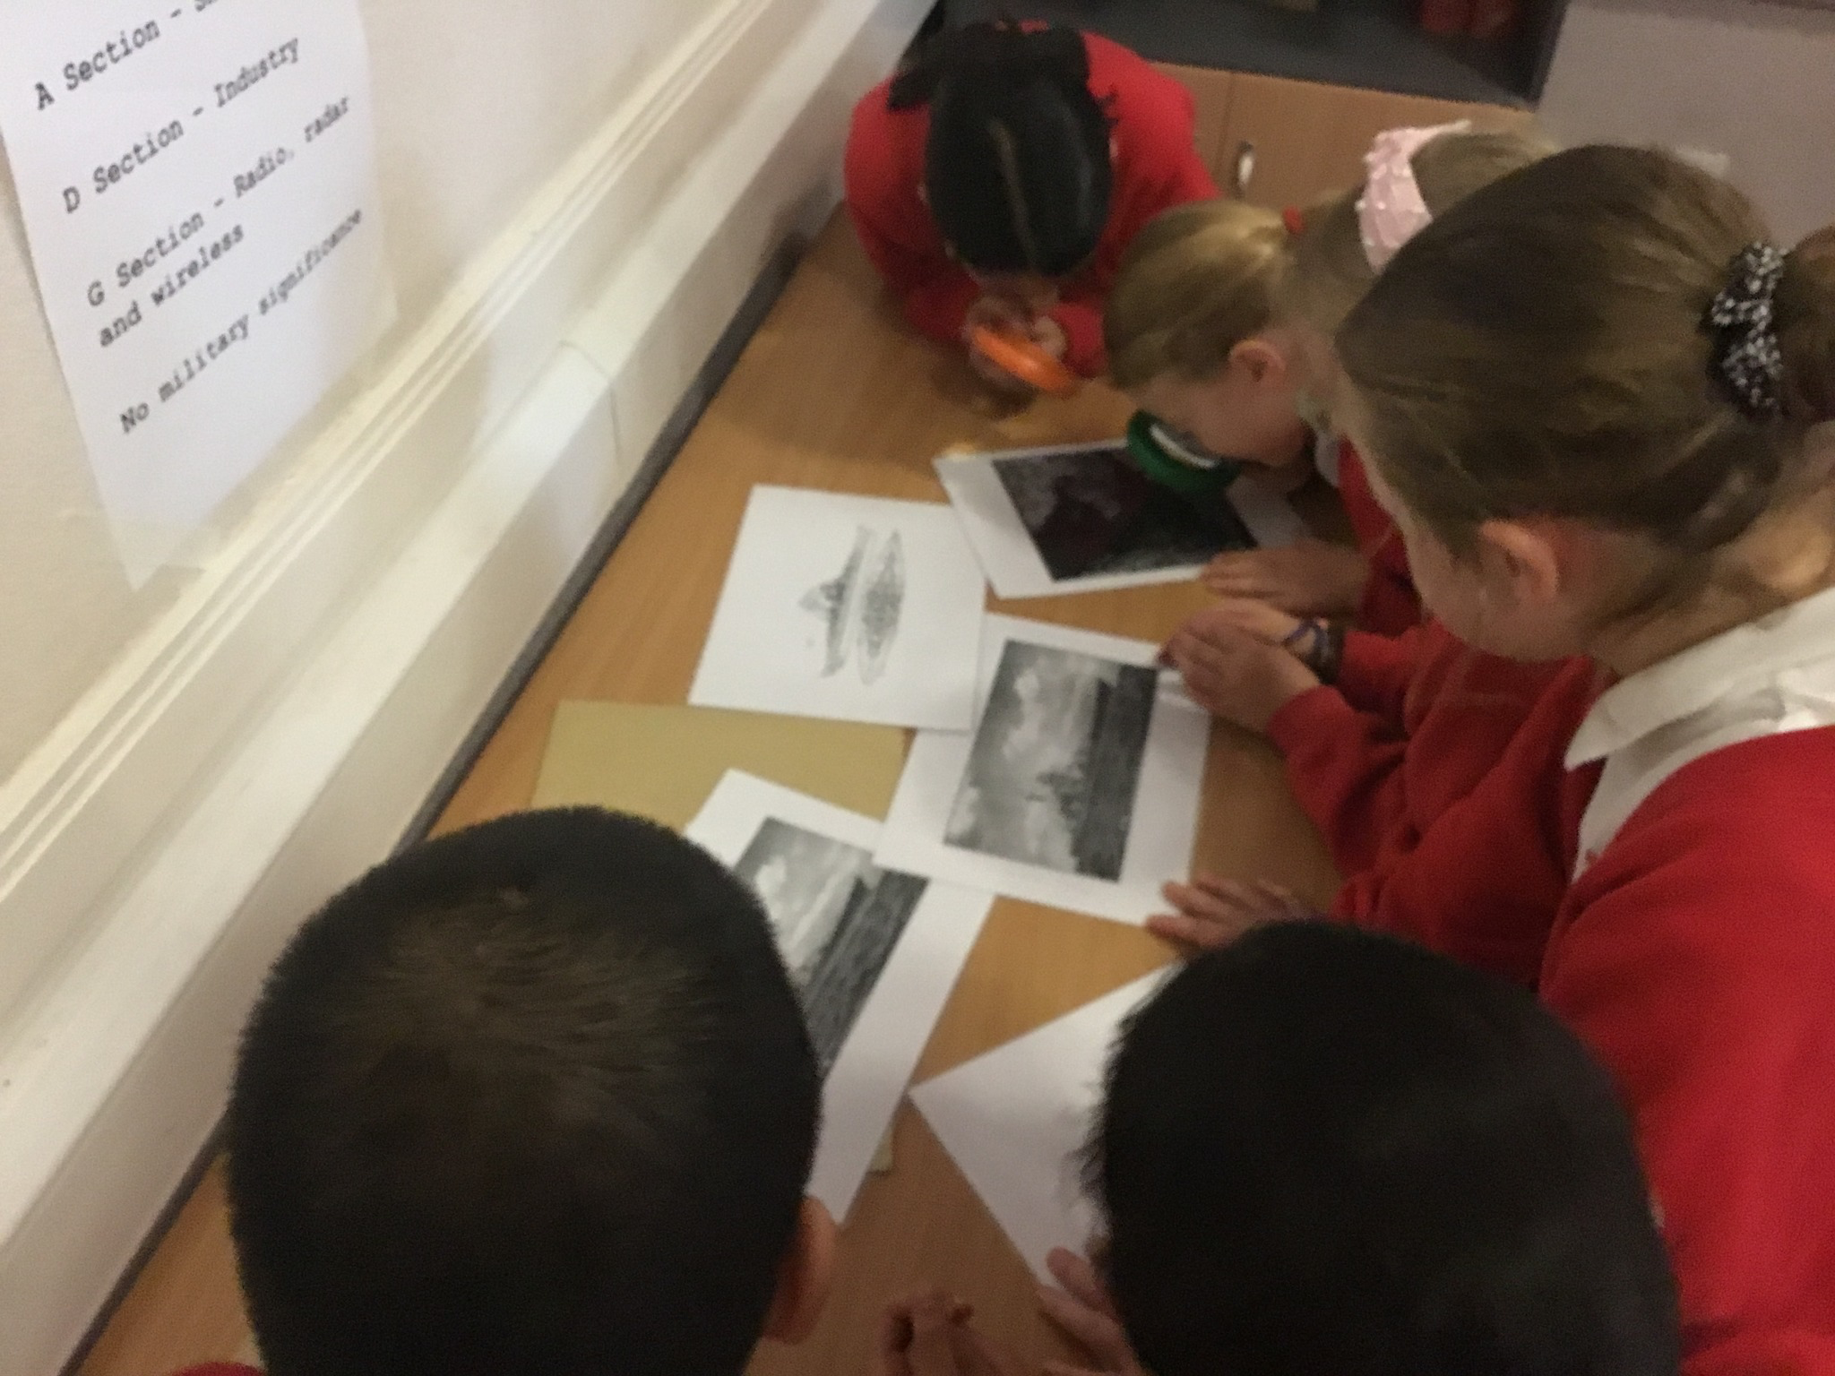
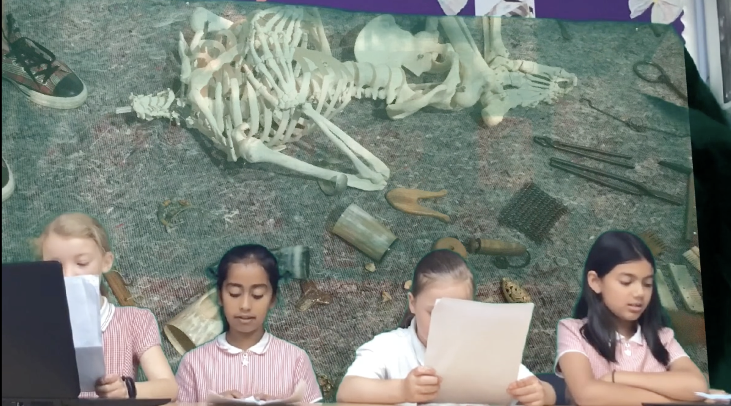
Photo Slide 2

Slide 31
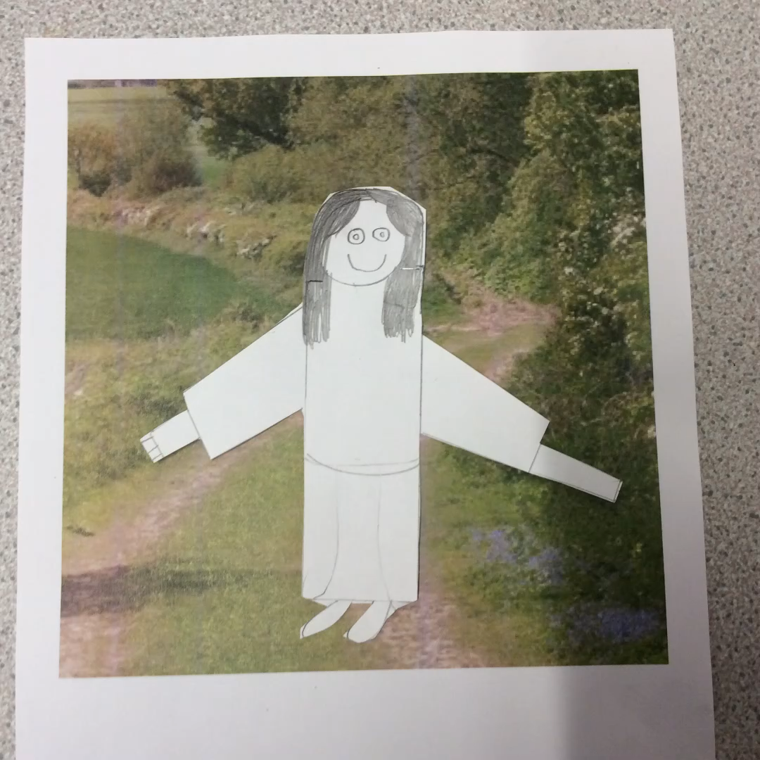
Using ‘Clips” to support learning
The children wanted to make videos and animations about the Pendle witches – they made the models and wrote the scripts.
Press on video to watch the video.

Slide 32
1.4 How does monitoring, marking and feedback help pupils make progress in history?
Evidence 1
The whole school monitoring with Mrs Smith (History Governor) was a great way to monitor and feedback to class teachers. By using the vocabulary words (linked to subject covered) the children were able to tell us all about the great fire of London and the Gunpowder plot. By using the key vocabulary – it showed any misconceptions or misunderstandings – example - the children were unsure about the houses of parliament building. This was fed back and re-covered. It was also reinforced in EYFS during their London topic – making sure the seeds are planted to be able to flourish as the child progresses.
The next slide shows the notes given to staff (went through at a staff meeting)

Slide 33
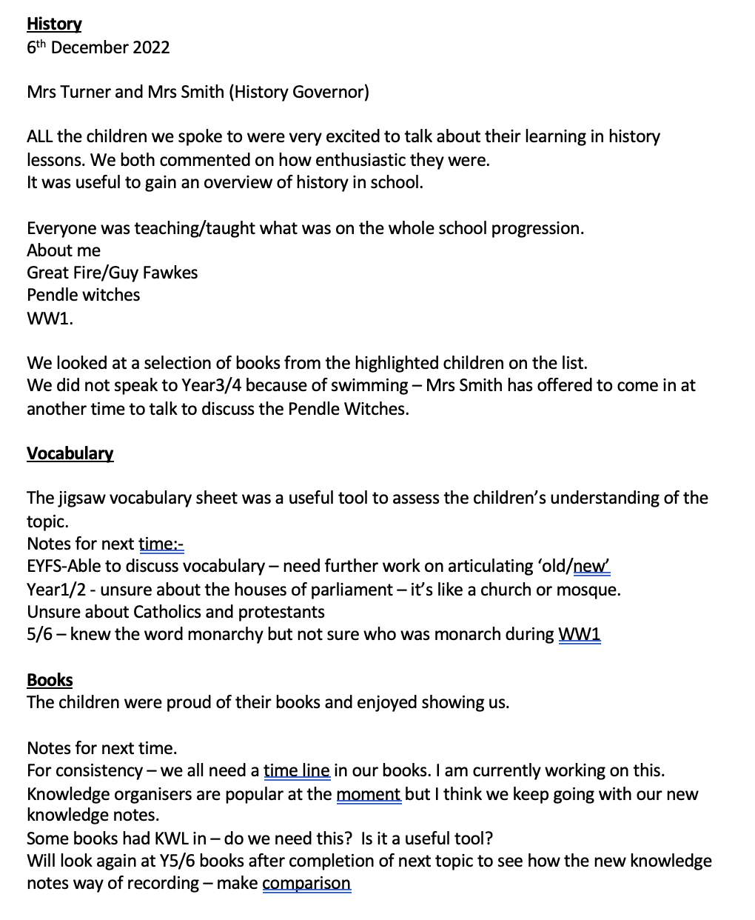
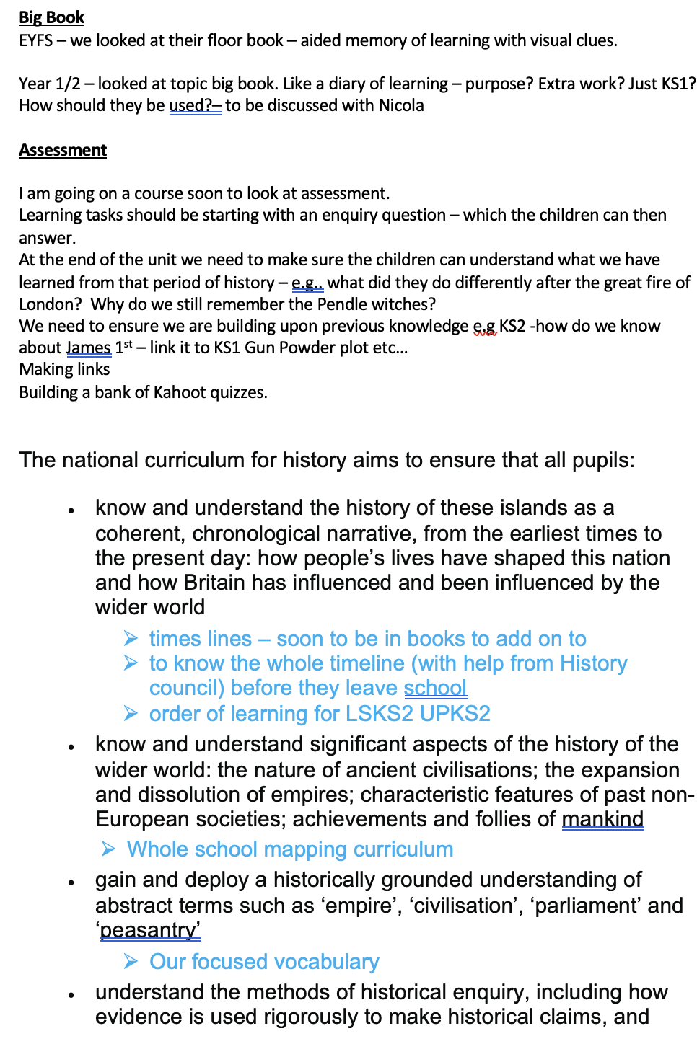
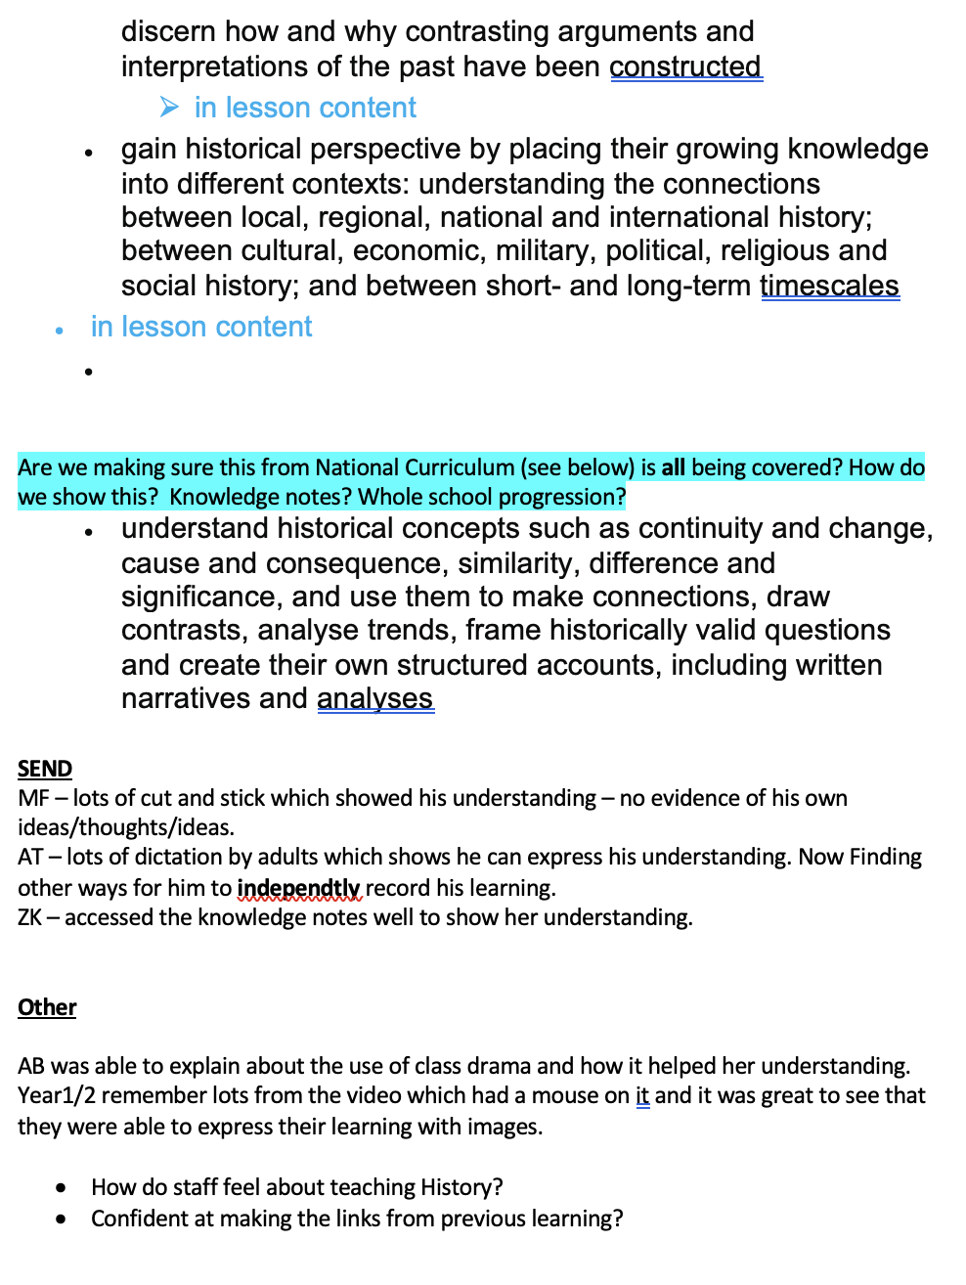

Slide 34
Evidence 2
Our British History timeline – Balderstone Style.
The timeline started a few years ago with David Brookhouse (Heritage Team) coming into school and demonstrating it to us. Since then – history council have evolved it and it keeps on evolving as we progress. The children wanted to make it more relevant to the subjects we were covering
Example – for the 20th century we were told to twirl and say ‘groovy baby’. The 60’s was a great decade (so I’m told) and the children had fun spinning round – but it didn’t mean anything to them – so history council chose WW1, WW2 and man on the moon as significant events we were learning about – to make the timeline meaningful.
History Council demonstrate the timeline every term to keep it fresh – they have also made children book marks and an outdoor version. Staff use it to refer back to and make links in lessons and hav e noticed that it helps the children make progress by making links.
To see our timeline – click on the link below.
KS1 also have access to a ‘within living memory’ timeline
KS2 have access to British timeline matched with World history.
https://www.balderstoneschool.co.uk/page/?title=British+History+Timeline+%2D+Balderstone+Style&pid=204

